Slide 1
CVRP Capacitated Vehicle Routing Problem
Group 14
Madalena Sampaio 93294
Maria Cardoso 93661
João Rosado 96409

Slide 2
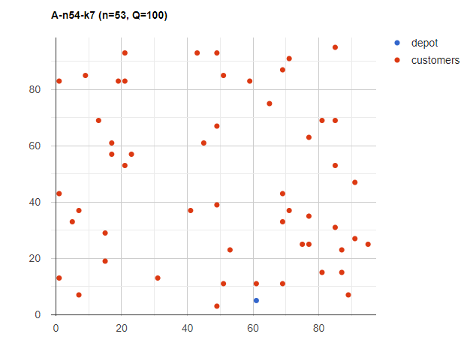
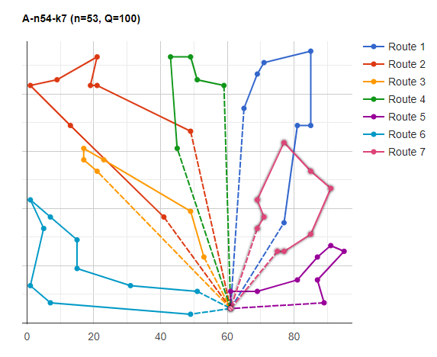
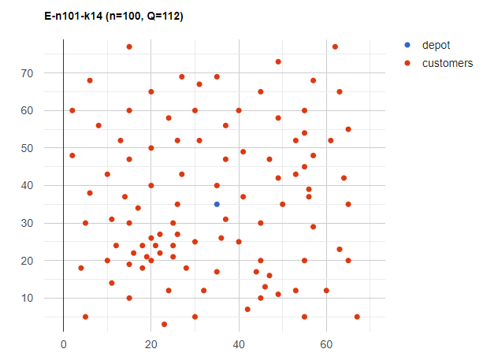
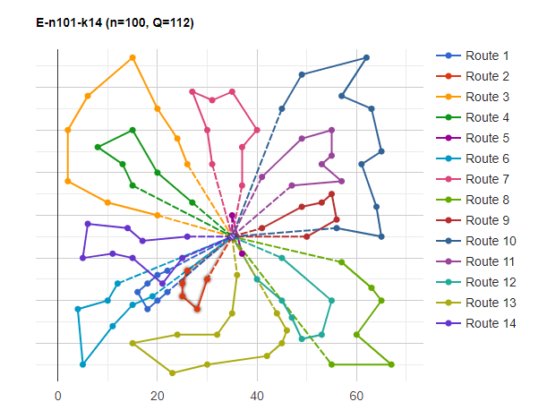
Benchmarks
CVRPLIB: Capacitated Vehicle Routing Problem Library
A-n54-k7:
53 nodes + depot
E-n101-k14:
100 nodes + depot

Slide 3
Methods used
CVRP
Heuristics
Sweep Algorithm
Nearest Neighbor
Metaheuristics
Artificial Bee Colony
Ant Colony Optimization

Slide 4
Sweep Algorithm
Benchmark | A-n54-k7 | E-n101-k14
No. of nodes | 53 | 100
Min. No of trucks | 7 | 14
Truck capacity | 100 | 112
Optimal Cost | 1167 | 1071
Sweep Algorithm Cost | 2361.56 | 2604.5
Error | 102% | 143%
With 2-opt algorithm:
Benchmark | A-n54-k7 | E-n101-k14
Optimal Cost | 1167 | 1071
Sweep Algorithm + 2-opt Cost | 1614.85 | 1722.82
No. positions changed | 8 | 2
Error | 38.0% | 61%

Slide 5
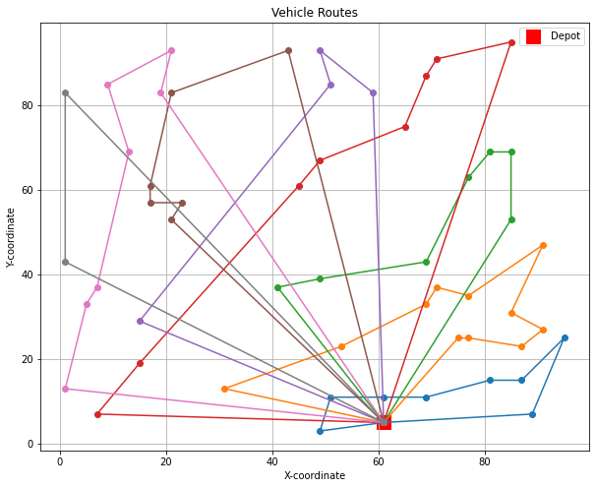
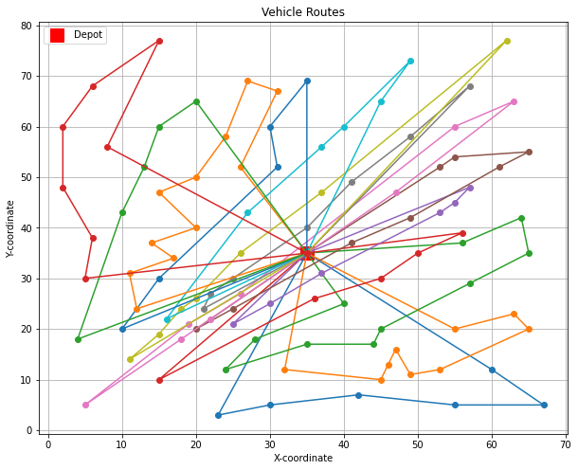
Sweep Algorithm
A-n54-k7:
Total Cost: 1614.85 (Optimal: 1167)
E-n101-k14:
Total Cost: 1722.82 (Optimal: 1071)

Slide 6
Nearest Neighbors
Benchmark | A-n54-k7 | E-n101-k14
No. of nodes | 53 | 100
Min. No of trucks | 7 | 14
Truck capacity | 100 | 112
Optimal Cost | 1167 | 1071
Nearest Neighbor Cost | 1433.64 | 1610.91
Error | 22.8% | 50.4%
With 2-opt algorithm:
Benchmark | A-n54-k7 | E-n101-k14
Optimal Cost | 1167 | 1071
Nearest Neighbor + 2-opt Cost | 1412.09 | 1609.95
No. positions changed | 8 | 2
Error | 21.0% | 50.3%

Slide 7
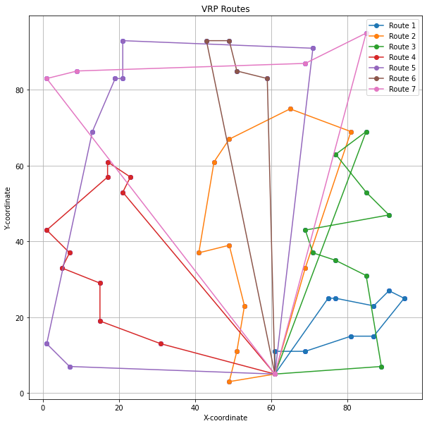
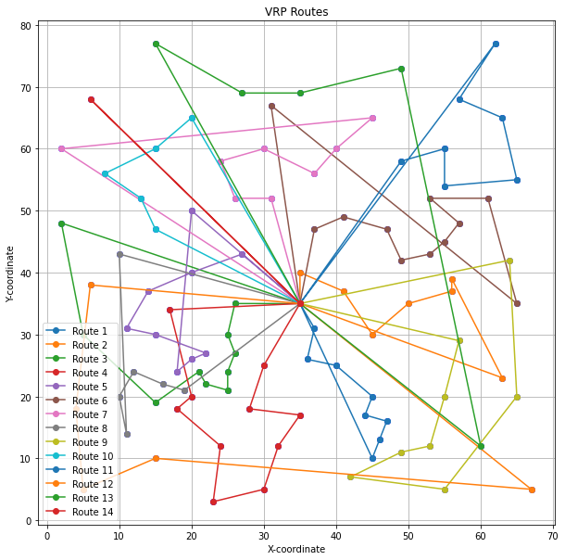
Nearest Neighbors
A-n54-k7:
Total Cost: 1412.09 (Optimal: 1167)
E-n101-k14:
Total Cost: 1609.95 (Optimal: 1071)

Slide 8
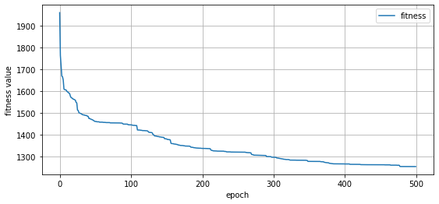
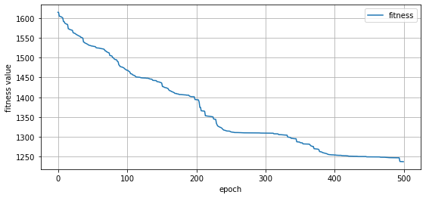
Artificial Bee Colony
A-n54-k7
Benchmark | A-n54-k7 | E-n101-k14
No. of nodes | 53 | 100
Min. No of trucks | 7 | 14
Truck capacity | 100 | 112
Optimal Cost | 1167 | 1071
ABC Cost | 1260.4 | 1230.9
Error | 8.0% | 14.9%
E-n101-k14

Slide 9
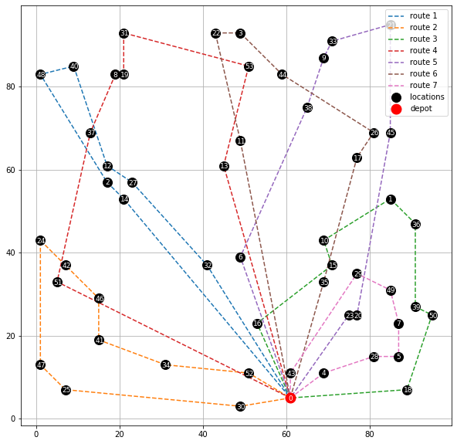
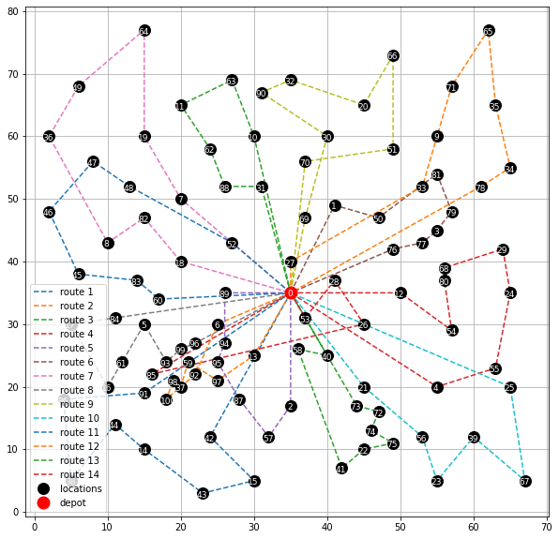
Artificial Bee Colony
A-n54-k7:
Total Cost: 1260.4 (Optimal: 1167)
E-n101-k14:
Total Cost: 1230.9 (Optimal: 1071)

Slide 10
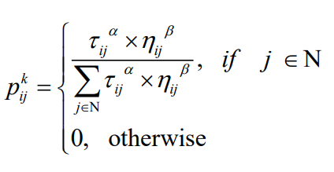
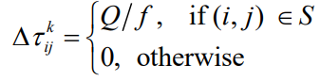
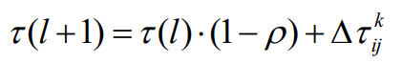
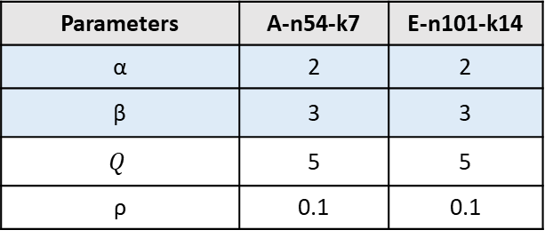
Ant Colony Optimization
Parameters Settings:
Benchmark | A-n54-k7 | E-n101-k14
No. of nodes | 53 | 100
Min. No of trucks | - | -
Truck capacity | 100 | 112
Optimal Cost | 1167 | 1071
ACO Cost | 1338.13 | 1315.85
Error | 14.7% | 22.9%
Parameters | A-n54-k7 | E-n101-k14
α | 2 | 2
β | 3 | 3
$$Q$$ | 5 | 5
ρ | 0.1 | 0.1

Slide 11
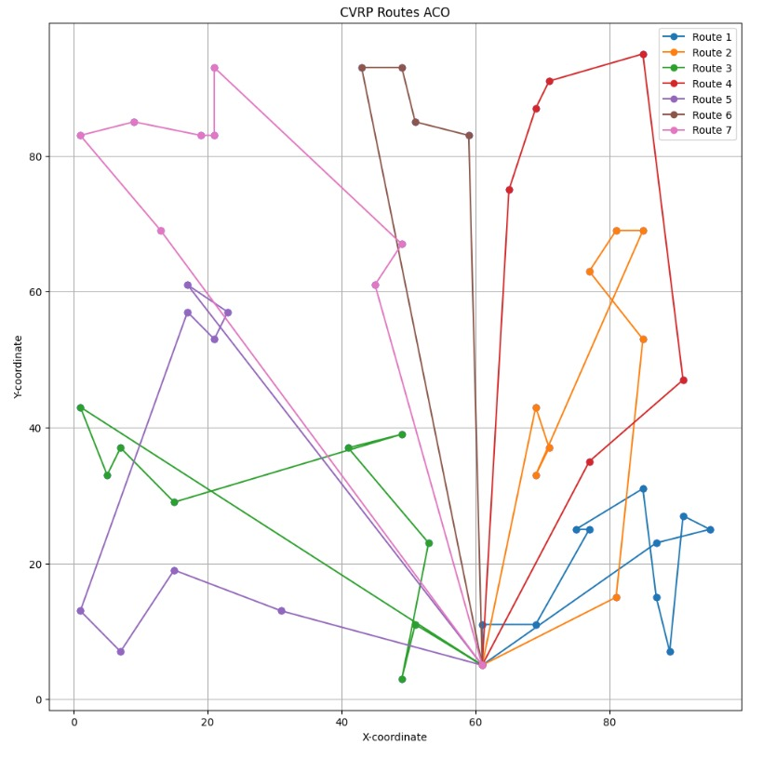
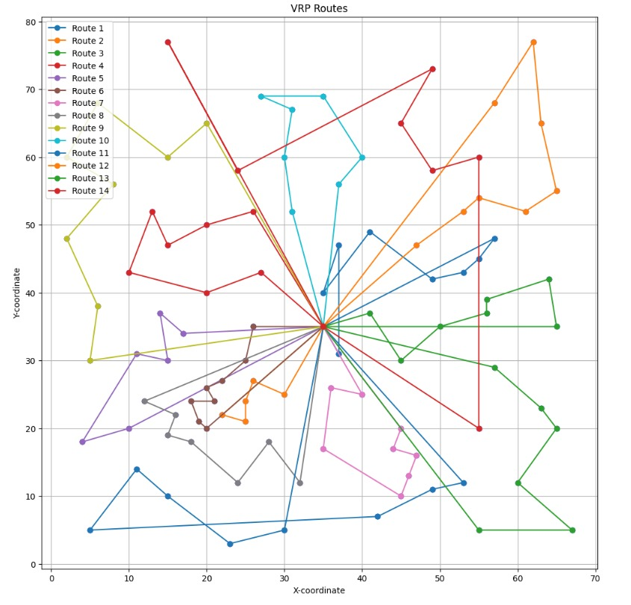
Artificial Bee Colony
A-n54-k7:
Total Cost: 1338.1 (Optimal: 1167)
E-n101-k14:
Total Cost: 1315.9 (Optimal: 1071)

